Slide 1
Rebuilding Steady State: get the power of virtual machine snapshots on your physical copy of Windows 7/R2… for free
presented by Mark Minasi (@mminasi)
help@minasi.com
www.minasi.com

Slide 2
What's This All About? one way to understand Steadier State
If you liked Microsoft's SteadyState and wish they hadn't gotten rid of it, Steadier State may answer that wish
If you've never heard of SteadyState but think it'd be cool to have the power of a virtual machine's snapshots implemented on a physical machine running Windows 7 or R2, you may like Steadier State
In more detail…

Slide 3
The Problem
You're in charge of a bunch of PCs used by random people who are clueless/don't care
Classroom labs
Libraries
Kiosk machines
Multiple-user workstations
It's your job to quickly and easily un-do everything they've done to get ready for the next class/patron/user etc… undo in minutes

Slide 4
The Answer
Well, there are plenty of 'em, but they tend to be either slow or expensive
Microsoft used to give away a nice answer called "SteadyState," but they don't any more, and never supported Windows 7
Fortunately, there's a "SteadyState" hidden inside Windows 7 (kind of), and so I've tried to make it easy to use, so I decided to give it away and call it "Steadier State"

Slide 5
Steadier State in Short
Works with Win 7 Enterprise/Ultimate, R2
Aimed at systems with one physical hard disk that tend not to contain user-specific data – i.e. lab systems, kiosks, public-access PCs at risk of infection/disk damage etc
Implements complete roll back in 3-4 mins
Incorporates a tool to allow you to update an image, resetting the rollback point
Free

Slide 6
More Concrete SS Example
Students come into a 30-PC classroom lab and work from 9 AM to 10:15 AM
Between 10:15 AM and 10:30 AM, you have to undo everything they've done on all 30 machines… in under 15 minutes, as the next class starts at 10:30
If they've got Steadier State, just tell them to reboot their computers and as soon as Windows comes up, Boot Manager appears:

Slide 7
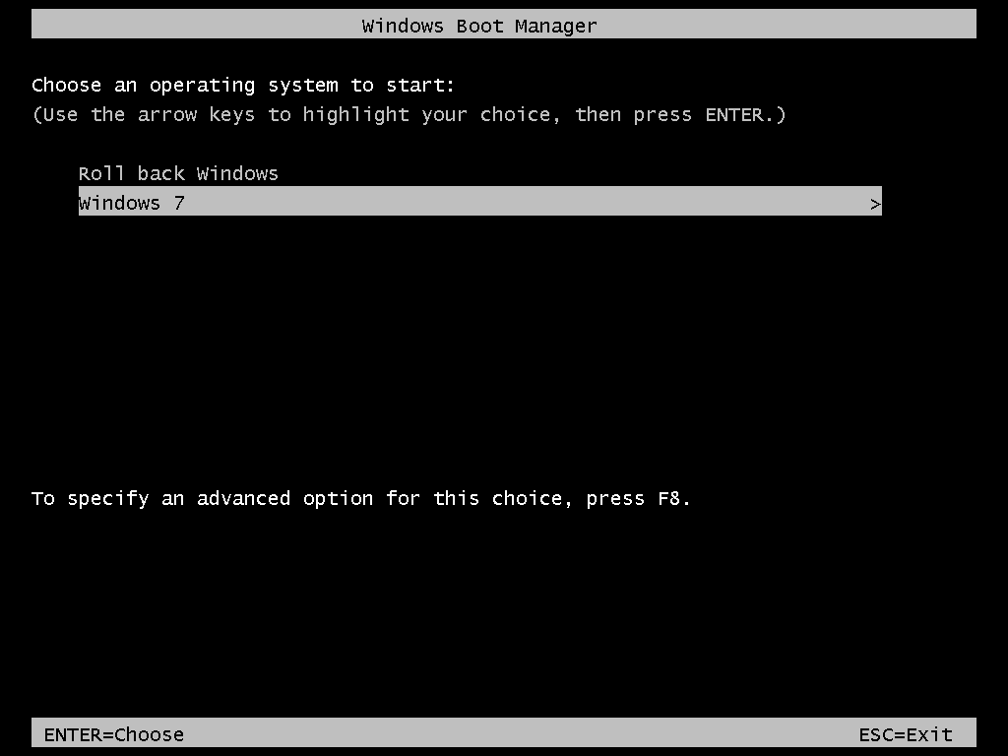

Slide 8
Steadier State Boot Manager
If they choose "Roll Back Windows" and press Enter, they can just walk away, as Steadier State will simply roll back, reboot and start up the rolled-back Windows 7
The "Roll Back Windows" boots a different copy of Windows – "WinPE" (explained soon) – that manipulates the files from the "Windows 7" OS boot entry to roll back any changes and reboot, restoring Windows 7

Slide 9
Agenda
Steadier State Pros and Cons
The Enabling Technologies
Steadier State Setup in Words and Pictures
Improving Steadier State: Tweaks and Tips
Updating and Maintaining Steadier State Systems
Reference Section: How the Command Files Work

Slide 10
Steadier State: Pros and Cons

Slide 11
Steadier State Advantages
Rolls back any and all changes on C: in minutes
Simple one-step user/admin action – click , walk away, in three/four minutes there's an automatic rollback
Adds a copy of WinPE, a "maintenance Windows" onto your system's hard disk, costing little space and adding value fixing-wise
All built in batch, easily modified if desired
The partition containing the Steadier State code is invisible to users, but admins can access it easily if desired

Slide 12
Disadvantages
Only works on Enterprise/Ultimate and all versions of R2, not Windows 7 Professional
Aimed at one-physical-drive systems
Requires a physical drive with free space roughly equal to 2.5 times the maximum size of the image file ("image.vhd") – an 80 GB C: rollback-enabled system needs up 200 GB of disk space
A side-effect of how Windows handles the snapshot information delays reboots by 60-90 seconds in my experiments

Slide 13
The Enabling Technologies
Skip this section if you like and go straight to "Steadier State, Step by Step," but if you don't know what "VHD," "bcdedit," "WinPE," "differencing disk" or the like are, it's worth your time

Slide 14
Howzitwork? Five Technologies
Before getting into the meat of what Steadier State does and, more importantly, how it does it, let's talk about five already-existing geeky Windows concepts, for those who may not have had time to look into them
Windows Preinstallation Environment (WinPE)
VHD (virtual hard disk) files
Differencing VHDs
Boot physical PCs from VHDs
Windows Boot Manager
Steadier State can exist because of them

Slide 15
Background: WinPE
A version of Windows small enough to fit on a CD or USB stick, intended for deployment and maintenance
Very minimal GUI, 99% command line
Can't install traditional Windows applications
No start menu
Has essentially full Windows support for networking commands/drivers, storage commands/drivers
Distributed in the Windows Automated Installation Kit (WAIK), free download from Microsoft
Two versions in the WAIK, 32-bit and 64-bit
BuildPE installs a copy of WinPE on the Steadier State USB stick and/or CD (SSB)
WinPE always runs a file "startnet.cmd" upon startup that Steadier State modifies to automate a number of processes, including the one-click Windows rollback

Slide 16
Background: VHD (VHD="virtual hard disk")
Virtual machines need imaginary ("virtual") hard disks – VM managers implement that as files on the host's hard drive
VMWare tools use .vmdk files, Microsoft virtualization tools use .vhd files and have since MS bought VPC in 2003
Essentially an entire drive – MBR, partitions and all – are encapsulated in one big file
Windows 7/R2 lets you "attach" a VHD to your system, essentially mounting it as a drive letter – or letters, as hard disks can be partitioned

Slide 17
Background: Differencing Disks
Windows virtualization tools have (at least since 2005) let you create not only simple VHDs but also differencing VHDs
When you create a differencing VHD, you name a VHD that is its "parent"

Slide 18
Undo disks
Virtual machine uses this as C:
image.vhd
"image.VHD," file that some virtual machine sees as "C:" – all changes to C: change the contents of the file image.vhd
Normally, virtual systems need at least one virtual hard disk which is, again, represented as a file with the extension .vhd. Any changes that you make to the virtual disk are stored as changes to the .vhd file.

Slide 19
Undo disks
Virtual machine uses this as C: now
Doesn’t change any more
Parent disk image.vhd
differencing disk snapshot.vhd
Changes all the time
If, on the other hand, you want to freeze the current contents of the image.vhd file but want the virtual machine to be able to still change C:, then you can create a new disk called a "differencing disk" wherein you tell Windows that its "parent" is image.vhd. Virtual machines that used to use image.vhd can now instead use snapshot.vhd and things look just as they did before… but all changes to "image" get written to "snapshot."

Slide 20
Undoing Changes
The value of snapshot.vhd in this example is that it allows you at any time to roll back all changes made to "C:" since you created the differencing disk…
… all you need do is to delete snapshot.vhd and create a new empty differencing disk also named snapshot.vhd
The VM now sees C: as it was earlier (as it's just looking for something called snapshot.vhd)
(It is alternatively possible to merge snapshot.vhd's contents into image.vhd, ensuring that post-snapshot changes are preserved)

Slide 21
Background: Boot from VHD
Windows 7/R2 introduced the notion that you could create a bootable hard disk in a VHD and boot a physical system from that VHD
Thus, your PC could boot off one big "image.vhd" file containing its C:, meaning that your "deployment tool" would be XCOPY
Microsoft blocks Windows 7 Professional and below from supporting boot-from-VHD, so this is only possible with Enterprise, Ultimate, and every version of Server 2008 R2

Slide 22
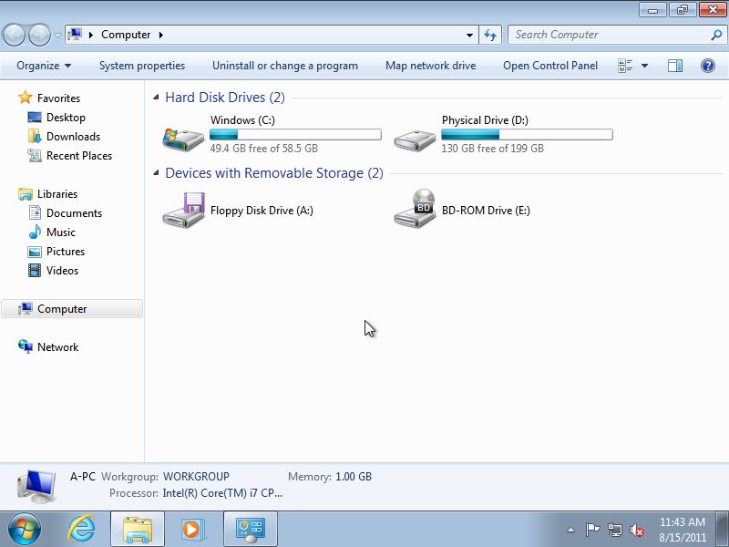
What Boot-From-VHD Looks Like
On this system, I've got just one actual volume, the "Physical Drive" volume on the right. The drive showing as C: isn't a real drive, it's the volume inside image.vhd / snapshot.vhd. D: (which may be a different drive letter depending on whether your target PC has an optical drive etc.) is the drive that is the real C:, so to speak. In fact, if you look inside D:…

Slide 23
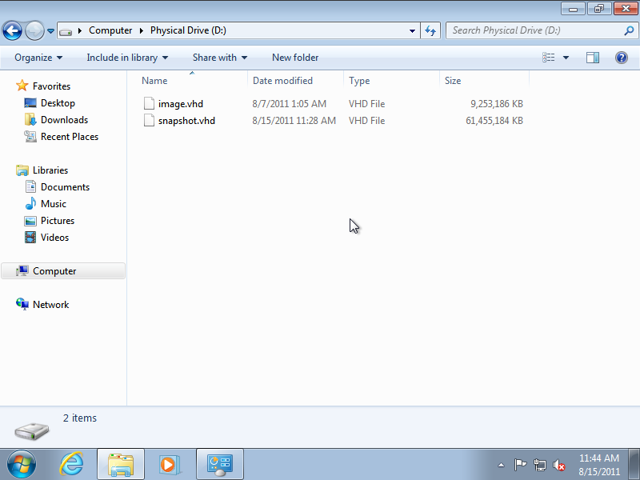
What Boot-From-VHD Looks Like
This – the "real" drive C: -- contains just two files, image.vhd and snapshot.vhd. Again, all changes to image.vhd will get written to snapshot.vhd, not image.vhd, and snapshot.vhd shows up as C: as we saw in the previous screen shot. Again, we're running Windows here on a physical system, not a virtual one, although we've packaged our C: drive in the format of a virtual drive.

Slide 24
Background: Boot Manager
As with Windows NT since 3.1, we often need to be able to boot more than one operating system on a single PC
NT 3.1 through Server 2003 R2 booted from something called NTLDR and used boot.ini text file
Vista and later boot instead from the BOOTMGR executable and are driven by a file named \boot\bcd, which is not a text file

Slide 25
Background: Boot Manager
Systems booting from BOOTMGR show a text menu offering options ("OS entries"), a default option and waits a given number of seconds before automatically choosing the default
(If there's only one OS entry, then you don't see the Boot Manager window, of course… there are no choices)
Administrative tool is "bcdedit.exe"
To do boot-from-VHD, you install a .vhd file on your system and create an OS entry that tells bootmgr to boot from that .vhd file

Slide 26
Steadier State Setup in Words and Pictures
Installing, Converting, and Deploying with Steadier State

Slide 27
Making Steadier State Work just three steps to steadiness
Install Steadier State to create a Steadier State bootable USB stick/CD
Convert a PC to rollback ability: boot it with the SS USB/CD, then convert the machine to Steadier State format ".vhd"-type file
Deploy the VHD to any PC by booting Steadier State USB stick, which prepares the PC for the VHD and SS -- then copy the VHD file over, reboot and you're ready to go – "Roll Back Windows" is always on the boot menu
That's high-level, here's a bit more detail

Slide 28
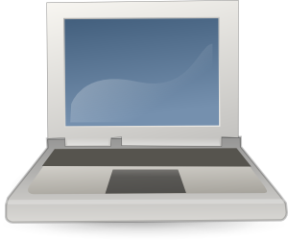


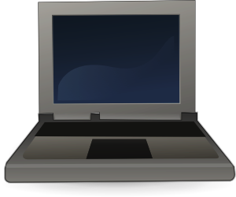
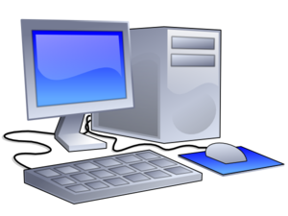
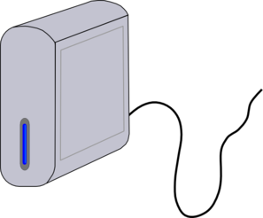
Meet the Players what you'll need…
A PC to play the role of "technician PC," which you download SS onto to create the Steadier State boot USB stick/CD ("SSB")
The aforementioned SSB in its two possible forms, which you'll create with Steadier State
A "prototype" PC which provides the copy of Windows 7 that you want to protect with Steadier State. It's a PC upon which you've built your kiosk software, your lab image, etc. You may or may not have Sysprepped it, that's up to you – more on that later. You use SS to create a file called "image.vhd" that you deploy to…
… one or more "target" PCs, systems that you'll run Windows 7 under Steadier State on
You'll also want some external storage to save and transport image.vhd on
(Note that one PC could play all three roles.)

Slide 29
Step 1: Create SS Boot USB/CD download WAIK and SS to "technician PC"
microsoft.com
steadierstate.com
Windows Automated Installation Kit (WAIK)
(download ISO, mount it or burn it to a DVD, run startcd.exe and choose "Windows AIK Setup")
Steadier State files
(download zip file, create folder c:\sdrstate and copy .cmd and .bmp files to c:\sdrstate)
Technician PC

Slide 30
Step One: Get Files, Install SS get the WAIK
You'll want to set up a "technician PC" (which could be any machine, you only need it briefly) so that you can create the Steadier State USB stick and/or CD ISO
First, get and install the WAIK – go to www.microsoft.com/downloads and search on "WAIK Windows 7" and get the 5 August 2009 "The Windows® Automated Installation Kit (AIK) for Windows® 7" – it says the file is 1 GB, but it's 1.7 GB
Install it on your system by running startcd.exe – it's an ISO, so burn it to a DVD or use an ISO mounter like Slysoft Virtual Clone Drive

Slide 31
Step One: Get Files, Install SS getting the Steadier State files
At the same system, go get the Steadier State files
They're at www.steadierstate.com
It's a zip file, sstate.zip containing some .cmd files and two .bmp files.
Create a folder c:\sdrstate and copy the files there
Now you're ready to create a Steadier State USB stick and/or CD-sized ISO file

Slide 32
Step 1: Create USB stick/CD Create SS bootable USB stick/CD with BuildPE
Run buildpe, and it'll create a Steadier State bootable USB stick and/or CD (SSB)… the only Steadier State tool you need
Technician PC
Buildpe
Once you've built your Steadier State boot device (SSB), you don't need the Technician PC any more (and in fact that PC can act as the Prototype PC and/or a Target PC)

Slide 33
Step 1: Create USB stick/CD running BuildPE
Open an elevated command prompt, go to c:\sdrstate and type "buildpe"
Follow the prompts from there to create the Steadier State USB stick and/or CD ISO file
Warning: you are going to wipe the USB stick entirely clean, and you must specify a drive letter to identify the USB stick to BuildPE… be very careful about that drive letter, as BuildPE cannot detect what is and isn't a USB stick!

Slide 34
Step 1: Create USB stick/CD BuildPE prompts
BuildPE asks
Do you want to create a Steadier State bootable USB stick?
If so, what drive letter should I find it at?
Would you like an SS ISO that you can use to burn a CD?
Should it create a 32-bit or 64-bit USB stick/ISO?
In what folder have you stored the Steadier State command files and .bmp files? (Probably c:\sdrstate.)
It reminds you that it's going to wipe the USB entirely, asks confirmation, and gets to work
Logs are in \windows\logs\buildpe
No further need for the technician PC, it's done its job

Slide 35
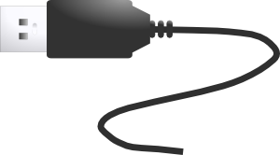
Step 2: Convert to image.vhd Boot prototype PC with SSB, attach external storage
"Prototype" PC = a PC whose copy of Windows and whose configuration you want to be able to protect with Steadier State, possibly Sysprepped before capture
Then attach some external storage with enough space to hold the image.vhd that you'll be creating
First, boot the prototype PC with either a CD or USB stick prepared with buildPE, a "Steadier State Boot device" (SSB)

Slide 36
Step 2: Convert to image.vhd get the PC ready, boot the SSB
Get a PC just as you want it – a "prototype PC"
Maybe Sysprep it (more in the later "details" section)
Boot the prototype PC with an SSB
Connect the PC to some sort of extra storage, as image.vhd will be a large file (although if you have the space, you can actually image a volume onto itself)
Figure out what drive letters are the \Windows drive and the external storage – WinPE likes to rearrange drive letters, so the drive that is C: normally almost certainly won't be C: once you've booted the SSB

Slide 37
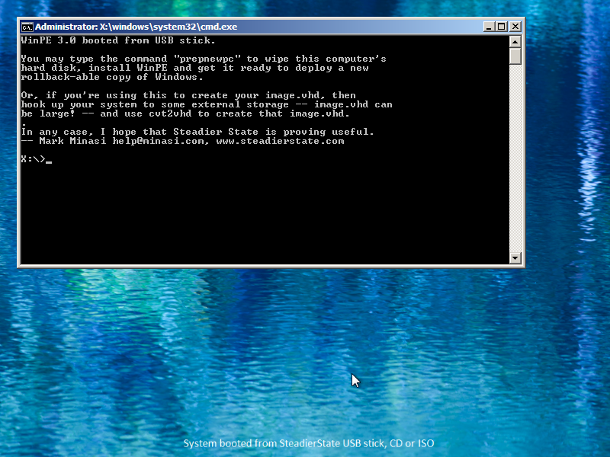
Screen After SSB Boot

Slide 38
Step 2: Convert to image.vhd Cvt2VHD syntax and usage
Needs to know volume to image and the folder to store its image.vhd to, and the maximum size image.vhd can grow to
Example: to save d: as image.vhd on the root of drive f:, capping image.vhd's size at 30 GB
cvt2vhd d: f: 30
another example:
cvt2vhd d: f:\32bitimage 30

Slide 39
Step 2: Convert to image.vhd note on setting the maximum VHD size
The maximum VHD size determines the required hard disk size on the system you'll deploy image.vhd to
The size of the physical volume that you will store the image.vhd onto must be at least 2.5 times the maximum VHD size
For example, if you do this:
cvtvhd d: f: 30
Then any PC you deploy the image.vhd to must have a C: with at least 30 x 2.5 = 75 GB free space
More info in the later "Steadier State Details" section

Slide 40
Step 2: Convert to image.vhd run cvt2vhd to convert Prototype PC's C: drive to image.vhd
The SSB contains a file cvt2vhd.cmd, which will image a drive on the prototype machine onto the external storage. All it needs is the drive letter of the volume containing the \Windows folder (the first parameter, and it's not always C:, as WinPE often temporarily rearranges drive letters), the drive letter of the external storage (the second parameter), and the maximum size that image.vhd will be permitted to grow to in gigabytes (the third parameter). This will take a while, depending on how fast your storage tech runs.
cvt2vhd d: f: 80
Notes:
Footnote: you can actually image a drive onto itself, but to do it, you'll need a drive that's no more than about one third full. (Needs space both for image.wim and image.vhd.)

Slide 41
Step 3: Deploy Image.VHD PrepNewPC: get the target PC ready to receive an image.vhd
A "target" PC is a PC that you want to deploy image.vhd onto. (You may be able to deploy a single image.vhd to many systems.) Steadier State systems need two partitions – a small 1 GB bootable partition and the rest a large C: drive onto which you've copied image.vhd.
prepnewpc
Fortunately, you don't have to do any fancy Diskpart-ing, Steadier State does it for you. Just (1) disconnect any external storage, (2) boot from your SSB, and then (3) run the "prepnewpc" command to prepare the target's hard disk. NOTE that PrepNewPC deletes all files on disk 0 of the target PC, so if there's anything that you care about there, please back it up first!
Notes:
In case it's not obvious, the technician, prototype and target systems could all be the same thing. For example, suppose you've got a PC whose configuration you're already pretty happy with, and just want to Steadier State it. Take that machine, download the WAIK and Steadier State onto it, create an SSB, boot the computer with the SSB, attach some external storage and cvt2vhd your C: drive onto the external drive. Then run prepnewpc on that system to wipe its hard disk and build SS's two partitions. Copy the image.vhd from the external storage to the new C: drive labeled "Physical Drive," and reboot.

Slide 42
Step 3: Deploy Image.VHD PrepNewPC details
Before running this, you should have booted from a Steadier State USB stick/CD (SSB)
Type "prepnewpc" and press Enter
Offers some intro information
Reminds you that it's going to wipe disk 0
Asks you to type a word, and from that point on, it works for a bit and then you have a ready-for-an-image PC

Slide 43
Step 3: Deploy Image.VHD copy image.vhd over
Once PrepNewPC is done, you should have a large C: drive with a volume label of "Physical Drive." Connect to whatever storage holds image.vhd and copy it to C:\.
image.vhd
image.vhd
Notes:
In case it's not obvious, the technician, prototype and target systems could all be the same PC. For example, suppose you've got a PC whose configuration you're already pretty happy with, and just want to Steadier State it. Take that machine, download the WAIK and Steadier State onto it, create an SSB, boot the computer with the SSB, attach some external storage and cvt2vhd your C: drive onto the external drive. Then run prepnewpc on that system to wipe its hard disk and build SS's two partitions. Copy the image.vhd from the external storage to the new C: drive labeled "Physical Drive," and reboot.

Slide 44
Step 3: Deploy Image.VHD a better way to copy an image: robocopy
Once you have a PC you've run "prepnewpc" on, "deploy" an image.vhd by copying it to the root of the drive labeled "Physical Drive" on that PC
The files can be large, so use the on-board copy of robocopy for fastest service, as in
robocopy e:\imagefiles d: image.vhd /mt:50
Note the syntax – source folder, destination folder, the particular file to copy
Remember the 2.5x rule for image.vhd and Physical Drive! Don't use the size of image.vhd currently, use the maximum size you specified when you ran cvt2vhd

Slide 45
Step 3: Deploy Image.VHD And once you've copied image.vhd, just reboot
Once that's done, disconnect the external storage and reboot. The system will automatically set up Steadier State at this point and then automatically reboot. After that, you're ready to go. Just use your Windows 7 system as you would normally and, when you want to roll back all changes, reboot and choose "Roll Back Windows."
You've now deployed a Steadier State-ready PC

Slide 46
Updating and Maintaining Steadier State Systems
Accessing WinPE and updating your snapshots

Slide 47
Getting to the WinPE Prompt
As you've read, Steadier State adds a second copy of Windows to your system, a copy of WinPE
Useful for a couple of Steadier State tasks, and useful for several kinds of offline OS maintenance
To use it, though, you've got to get to its command prompt

Slide 48
Getting to the WinPE Prompt
First, create a file named "noauto.txt" into the root of any drive letter between C: and L:
Then reboot the system and choose "Roll Back Windows"
This will not roll back Windows; it'll just boot WinPE and leave you at the command prompt
Removable drives in C: through L: work

Slide 49
More on Noauto.txt
It doesn't matter what, if anything, is in noauto.txt
As it works on removable drives, you can access a non-booting system by putting a noauto.txt file in the root of a USB stick
Your SSB USB stick/CD already has a noauto.txt in its root, so you can use that
Do not, however, put noauto.txt in the root of the C: drive that you see when you're running Windows 7 (as opposed to WinPE), as that C: isn't a physical disk, it's a virtual one

Slide 50
More on Noauto.txt
Another good place is the drive labeled "Physical Drive," which is probably drive D: or E:
If you do want to roll back, just type "rollback" at the command prompt and press Enter, then just reboot and you'll be back in the pristine state

Slide 51
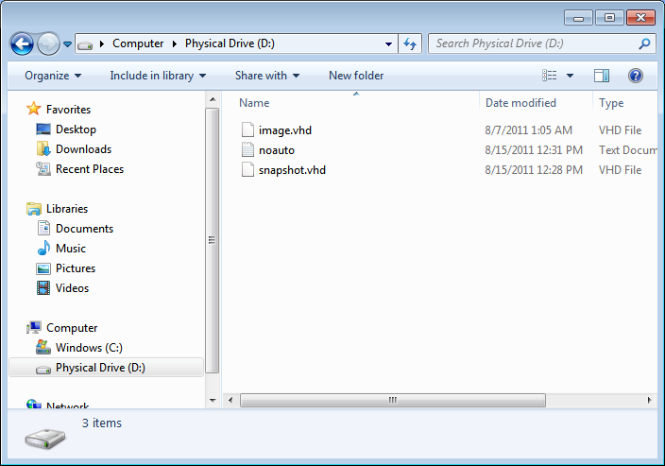
Noauto.txt Example Placement
Example location for noauto.txt – any contents of the "noauto.txt" file are irrelevant and unused.

Slide 52
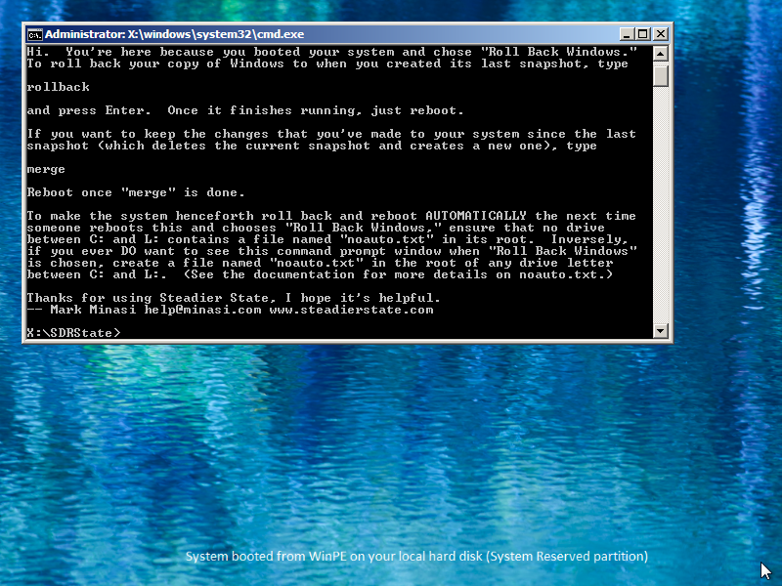
Running Rollback with Noauto

Slide 53
Retaining Changes: Merge
Sometimes you do want to keep the changes, such as when you patch a system or install new software
At that point, you can "merge," meaning
(1) Merge snapshot.vhd into image.vhd
(2) Create a new empty snapshot
In that case, use the "merge.cmd" command file

Slide 54
Retaining Changes: Merge
Understand, though, that once you merge snapshot.vhd into image.vhd, there's no way to return your system to the pre-merge state, short of first backing up the image.vhd
So, if you want to "permanently" install a patch, application etc then
First rollback to pristine image.vhd
Then install patches, software, etc
Create a noauto.txt
Reboot, choose "Roll Back Windows"

Slide 55
Retaining Changes: Merge
Once at the WinPE command prompt, type "merge" and press Enter
It'll remind you that this is irreversible and ask for a confirmation
Then you'll see a "100 percent complete" as Diskpart merges the .vhds… but it's a misleading notice, so don't be surprised if it doesn't take the cmd file another seven or so minutes to finish

Slide 56
Improving Steadier State: Tweaks and Tips

Slide 57
Topics
Multi-PC rollouts: Sysprep and SS
Choosing the right VHD size
Speed up SS (potentially) by creating fixed-size VHDs
User-proofing things by hiding "Physical Drive"
Customizing the Steadier State wallpaper
Multi-drive configurations

Slide 58
Multi-PC Rollouts and Steadier State
If you only intend to take a single PC and Steadier State-ize it, then it's simple – use Cvt2VHD to make its C: drive into an image.vhd, run PrepNewPC on the computer, copy the image.vhd back onto its C:, reboot and you're done
But what if you're creating one image.vhd that you want to deploy to 30 different systems in a computer lab?

Slide 59
Multi-PC Rollouts and Steadier State to Sysprep or not to Sysprep?
This is a problem that you already face if you're running a multi-PC room full of publicly-available systems, so you almost certainly currently have a way of taking one PC image and rolling it out to more than one system, and in my experience people have – ahem – strongly-held opinions about how it should be done, so I'm not here to tell you how to solve that problem, and Steadier State can help you no matter what method you use

Slide 60
Multi-PC Rollouts and Steadier State Sysprep simplification
One approach involves Sysprep, which is found in the \windows\system32\sysprep folder
An annoying side-effect of Sysprep on Windows 7 is that every time you run it, you lose a "rearm" and you only get three (four, if you've added SP1)
There is, however, a workaround – feed Sysprep an XML file with some commands in it and it will not burn a rearm
I have included two XML files in the Steadier State files to accomplish that, skiprearm32.xml and skiprearm64.xml
Notes:
Sysprep black belts can, of course, create more extensive XMLs

Slide 61
Multi-PC Rollouts and Steadier State Sysprep simplification
When you invoke Sysprep, tell it to use the file like this:
sysprep /oobe /generalize /shutdown /unattend:g:\skiprearm32.xml
(Change "32" to "64" if necessary)
Sysprep black belts can, of course, write more extensive XML files to simplify rollout
See newsletters 62, 71, 89
Notes:
Sysprep black belts can, of course, create more extensive XMLs

Slide 62
Choosing Your VHD's Max Size
Unfortunately the underlying Windows engineering forces us to give some thought to that maximum VHD size (the third Cvt2VHD parameter), so here's some advice – the rules are basically
Make that maximum as small as it can be
The physical volume that you copy the VHD to must be at least 2.5 times the maximum size of the VHD
Once Cvt2VHD has made your VHD, you can enlarge the VHD's maximum size, but you cannot reduce it

Slide 63
VHD Size Considerations
The image.vhd and snapshot.vhd must be on the same volume
The snapshot.vhd immediately grows to its maximum size, so if you had
image.vhd: 9 GB now, can grow to 80 GB
snapshot.vhd: no changes yet… but grows to 80 GB whenever you boot the system, rolling back upon shutdown
Thus, 2x is clearly necessary, but when merging the drive needs some scratch space, and my experiments seem to show that 2.5x will work – but if you can afford 3x, use it

Slide 64
Example
So let's say that you're deploying an image.vhd that you've given a max size of 50 GB. The image.vhd is at the moment no more than 13 GB in size. How large must the C: be to deploy this image.vhd?
Answer: 2.5x 50 = 125 GB
So you really, really do not want to find out that you did cvt2vhd and set a max of 70 GB but in reality never use more than 45 GB!

Slide 65
VHD Size Best Practice (IMHO)
When you run Cvt2VHD, set a fairly low maximum size. The pagefile will end up on the "Physical Drive" volume rather than the virtual C:, so don't worry about that
Then if necessary, just increase the maximum size – and remember, you can increase the maximum, but you can't reduce the maximum on a VHD
Steps to increase an existing VHD's max:

Slide 66
Increasing Image.VHD's Max Size
Boot to WinPE
Locate image.vhd's drive letter – for example, let's say it's c:\image.vhd – and type
diskpart
select vdisk file=c:\image.vhd
expand vdisk maximum=newvalue-in-MBs
exit
Reboot
example: to raise the max to 90 GB
expand vdisk maximum=92160

Slide 67
Blue Screen?
If you deploy an image.vhd to the "Physical Drive" volume but you've set that volume too small, you get a blue screen with a Stop Code of 136
So put it on a larger drive, or re-image your prototype PC giving cvt2vhd a smaller maximum size

Slide 68
Changing VHD Type to "Fixed"
Windows supports two kinds of parent VHDs – "fixed size" and "expandable"
Expandable are more flexible in the space they take and are faster to create, but can slow down when expanding
Cvt2vhd creates expandable VHDs, but some sources claim that creating fixed VHDs leads to better boot-from-VHD performance
I've not experienced that in my trials, but…

Slide 69
Changing VHD Type to "Fixed"
If you want cvt2vhd.cmd to create fixed-size VHDs, then find the line that includes "type=expandable" and change "expandable" to "fixed" – after that, save it and run that revised version of cvt2vhd to create your image.vhd
Again, you will slow down cvt2vhd noticeably – it can take about a minute to allocate 2 GB over a USB 2.0 connection in my tests

Slide 70
Hiding "Physical Drive"
As you've seen, you normally see something like C: ("Windows drive") and D: or E: (mostly empty-looking drive holding image.vhd and snapshot.vhd)
In case you've forgotten, here's what Explorer looks like on a vanilla Steadier State system

Slide 72
Hiding "Physical Drive"
You probably don't want users screwing with D:
Can we hide, say, D: from the users?
Yes, with a Registry hack; go to
HKEY_CURRENT_USER\ Software\Microsoft\Windows\CurrentVersion\ Policies\Explorer
You may have to create the Explorer key
Then create an entry of type "binary" called NoDrives

Slide 73
Hiding "Physical Drive"
Now it needs a value to know which drive(s) to hide; some values include
D: 08 00 00 00
E: 10 00 00 00
F: 20 00 00 00
Add together all of the values for all of the drive letters you want to hide, then put that value in NoDrives
This only applies to Explorer, not the command line
More info at http://support.microsoft.com/kb/555438

Slide 74
Changing Wallpaper
You'll notice that Steadier State uses custom wallpaper on WinPE with text to tell you whether you booted from SSB or the WinPE on the hard disk
You can change that if you like – just create an image that's 1024x768 and use it to overwrite winpe.bmp and winpe1.bmp in the \sdrstate folder
Then add some explanatory text

Slide 75
Changing Wallpaper Text
The idea is that it can be confusing to get to WinPE either via the USB stick/CD or the on-disk WinPE
So the wallpaper when you boot from the USB stick/CD is winpe.bmp and when you boot from the on-disk WinPE it's winpe1.bmp
The key, then, is to add an explanatory line of text at the bottom of winpe.bmp and winpe1.bmp to remind the admin where WinPE booted from

Slide 76
The Multi-Drive Story
I've noted elsewhere that Steadier State assumes that you're deploying it on systems with just one physical hard disk… why?
It boils down to boot order, as I've seen situations where BIOSes and/or Boot Manager get confused about which drive to boot
But in case you want to try it…

Slide 77
The Multi-Drive Story try a system with multiple drives by…
Make sure that the internal drive 0 is set in the BIOS as the first drive in the boot order
If that fails, check that you don't have an active partition on any of the other drives attached to the system – that includes external drives and USB sticks
If you're still having problems, , be sure to disconnect your external drives when booting WinPE

Slide 78
Reference Section: how the command files work
A guide to following what prepnewpc, merge, rollback, etc are up to while working for you – useful in case something goes wrong

Slide 79
What Cvt2VHD Does
Used to take a standard physical, on-disk-C: copy of Windows 7/R2 and repackage it as a file named image.vhd
What Cvt2VHD does:
Use ImageX /capture to image OS drive (first parameter) as "image.wim" to external drive (second parm)
Use Diskpart to create a VHD "image.vhd" on external drive
Mounts image.vhd as a drive letter
Uses ImageX to /apply image.wim to image.vhd
Leaves image.wim on external drive

Slide 80
What PrepNewPC Does
Wipes all partitions on disk 0 on target system
Creates a 1 GB active partition labeled "System Reserved," images WinPE onto it with ImageX
Creates a boot folder and bcd from scratch to enable WinPE boot, calling the WinPE boot option "Roll Back Windows"
Installs Steadier State files and ImageX
Partitions rest of the disk as a drive C: with the label "Physical Drive"
Modifies startnet.cmd to enable SS-oriented actions and advisory messages
Installs wallpaper for WinPE so admin knows whether she's running the WinPE from the hard drive or WinPE from the SS boot USB stick

Slide 81
What Rollback Does
Delete any existing snapshot.vhd
Create a new empty snapshot.vhd
Look in BCD for an already-existing "Windows 7" OS entry that boots from snapshot.vhd
If there isn't one already, create it and make it the default OS entry
Notice that this means that rollback.cmd also works to set up a first snapshot

Slide 82
What "Roll Back Windows" Does
When you choose "Roll Back Windows" from Boot Manager,
BCD tells BootMgr to load the WinPE partition
WinPE always runs windows\system32\Startnet.cmd
What Startnet.cmd does:
If there's no image.vhd on C:\, show a message suggesting some next steps and leave the command prompt on screen

Slide 83
Startnet, Continued
If image.vhd's there but snapshot.vhd isn't, then startnet runs rollback – which creates a first snapshot and also a BCD OS entry that does a boot-from-VHD from snapshot – and automatically reboots
If there's a file "noauto.txt" in the root of any of the drives between C: and L:, display a message suggesting some likely next moves and leave the user at the WinPE prompt

Slide 84
Startnet, Continued
If image.vhd and snapshot.vhd exist, and if there aren't any noauto.txt files, then – as in the "no snapshot" case – run rollback.cmd and automatically reboot. As "Windows 7" – the full-blown copy of Windows on Physical Drive – is the default, the effect is that you can choose "Roll Back Windows," walk away for a few minutes, come back and find Windows 7 running

Slide 85
What Merge Does
Checks you really want to do it
Uses Diskpart to merge snapshot.vhd's changes into image.vhd
Deletes old snapshot.vhd
Creates new empty snapshot.vhd
No BCD work, assumes that there's already a BCD OS entry that

Slide 86
Final Caveats
I have tested Steadier State on a variety of systems both physical and virtual, but I offer no guarantees at all… back up things you care about before committing to this
Remember, there's no way that Microsoft's going to support this, but it's easy to make an image "legal" by adding it to an existing Windows 7 system as a second OS option, a boot-from-VHD one

Slide 87
Notes
This is really intended for Win 7 desktop systems deployed on workstations with one physical hard disk – systems with more than one hard disk can have some odd "disk 0" configurations, so be careful in that case

Slide 88
Thanks for coming!
Give Steadier State a try, I'd love any feedback
Please be sure to fill out an evaluation
I'm at help@minasi.com
Thanks again and best of luck!

